Slide 1
Impact of SST warming on Tropical Cyclones occurred during 2017 Hurricane Season
Xingchao (XC) Chen, Fuqing Zhang
12/08/2017 Group Meeting

Slide 2
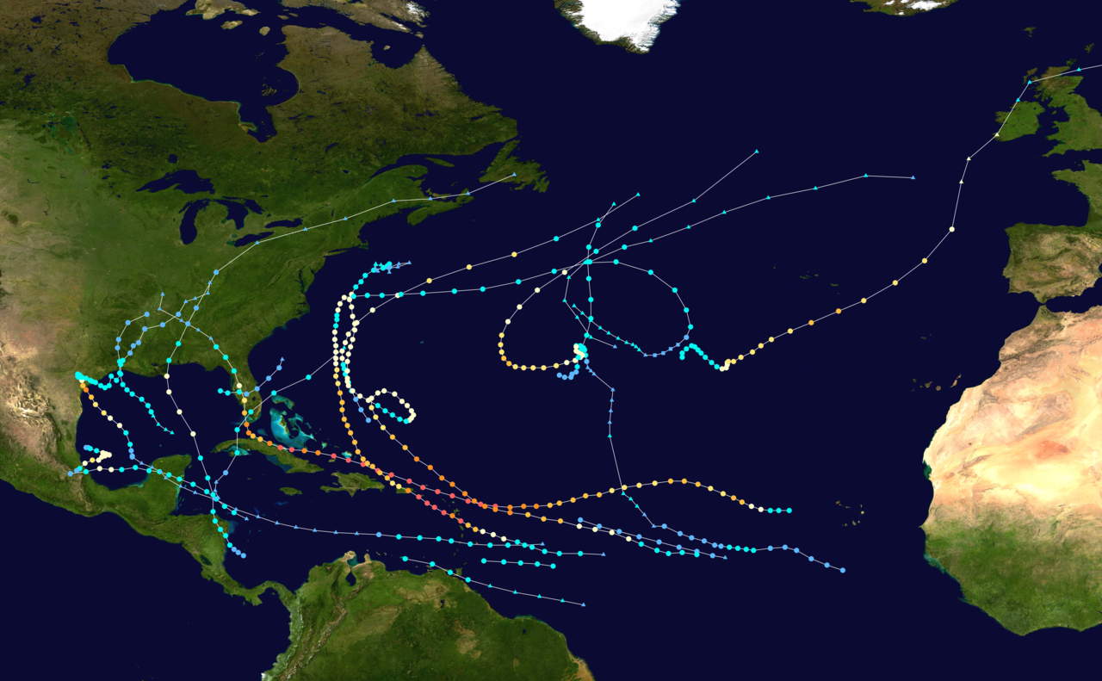
1. Background
2017 Hurricane Season
Total depressions | 18
Total storms | 17
Hurricanes | 10
Major hurricanes | 6
7th most intense Atlantic hurricane seasons since 1850
Costliest tropical cyclone season on record! (≥ $368.66 billion) , nearly all of which was due to three of the season's major hurricanes: Harvey, Irma, and Maria.
Climate Change? SST warming?
Debate is still continuing

Slide 3
1. Background
The development and evolution of tropical cyclones are strongly affected by both the SST and atmospheric dynamic forcing (Wang and Lee, 2008; Knutson et al., 2010):
a. SST provides the key thermodynamic forcing for TC: acts as a heat engine
(e.g., Olivier and Zhang, 2017)
b. Atmospheric dynamical forcings such as large-scale vertical wind shear and
vertical motion are also important (e.g., Zhang and Tao, 2013)
There is no disagreement that the changing of sea surface temperature is one of the key factors in affecting the TC climatology and that overall SST is rising due to the global warming (IPCC, 2013; Emanuel, 1988; Emanuel, 2005)

Slide 4
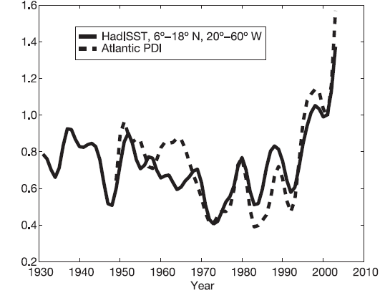
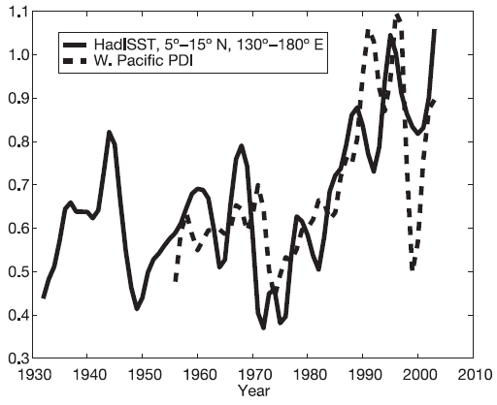
1. Background
Increasing destructiveness of tropical cyclones over the past 30 years
North Atlantic
Western North Pacific
(Emanuel, 2005, Nature)

Slide 5
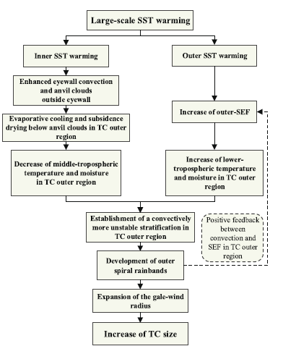
1. Background
Western North Pacific
North Atlantic
(Sun et al., 2017, Scientific Report)

Slide 6
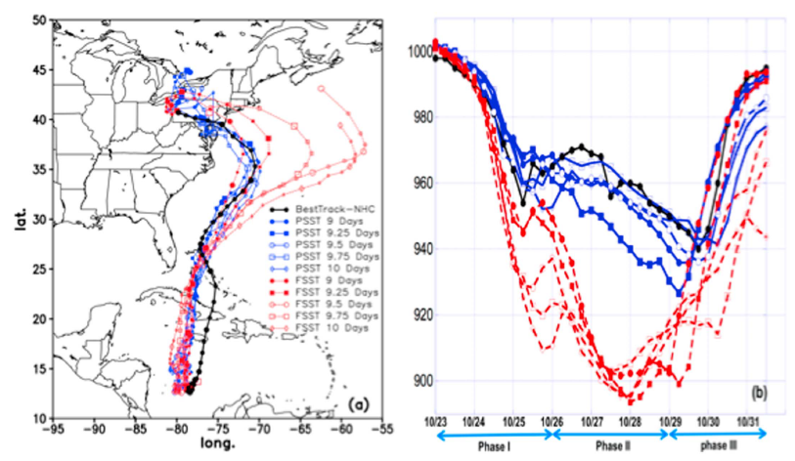
1. Background
Case study: Hurricane Sandy (9km grid-spacing)
(Lau et al., 2016, GRL)

Slide 7
1. Background
The objective of this study:
To understanding the possible responses of TCs occurred in 2017 hurricane season to the thermodynamical forcing of a warmer Atlantic Ocean, but under the present-day atmospheric conditions (compared with both the climatological and future SST).
The differences between the current study and previous works:
It is not a case study while simulates all hurricanes occurred in one season at gray zone resolution (9 km) without using cumulus schemes.
Compared to the past TC climatology studies, this study will compare the changes of each hurricane in the season induced by the SST changing.

Slide 8
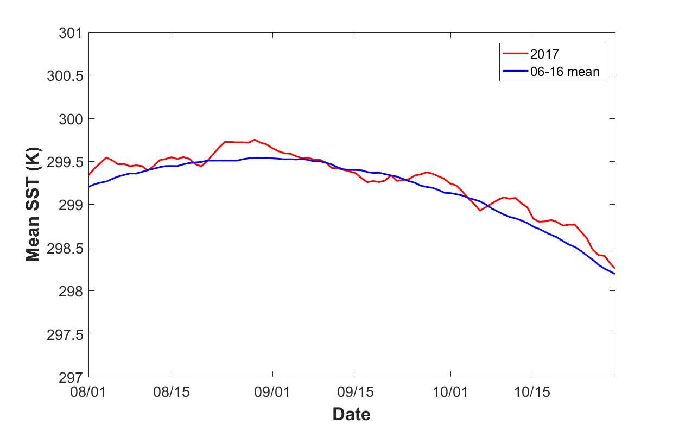
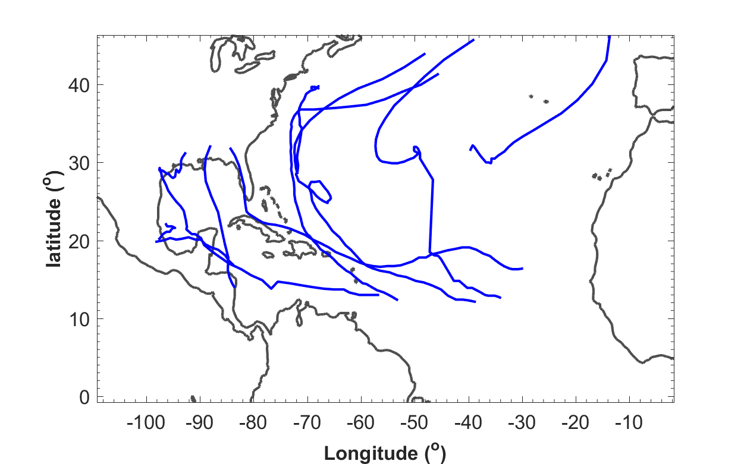
2. Numerical model and experimental design
Grid spacing | 9 km
Vertical levels | 45
Boundary Conditions | FNL
Model Domain
1. No convective parameterization scheme is used
2. Special nudging is used
Only horizontal wind field is nudged;
Above the boundary layer;
Only wavelength >1000 km;
E-folding time = 1hr;
Relaxed every 10 time steps
3. SST is updated every 6 hours using NCEP SST Analysis (1/12th degree)
2017 SST: Current SST
06-16 SST: Climatological SST averaged
over 2006-2016

Slide 9
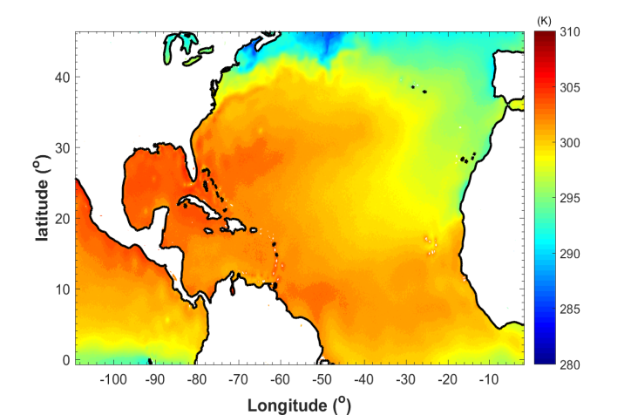
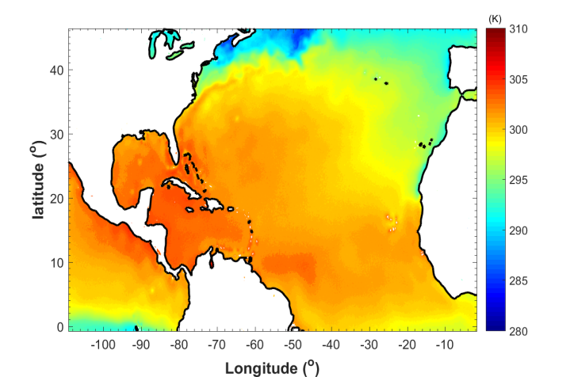
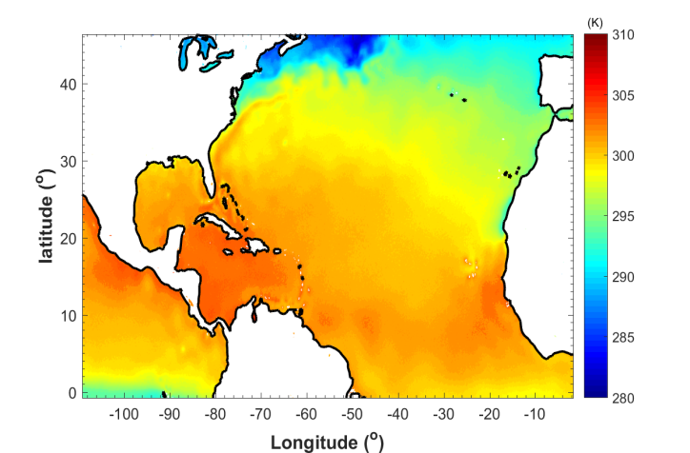
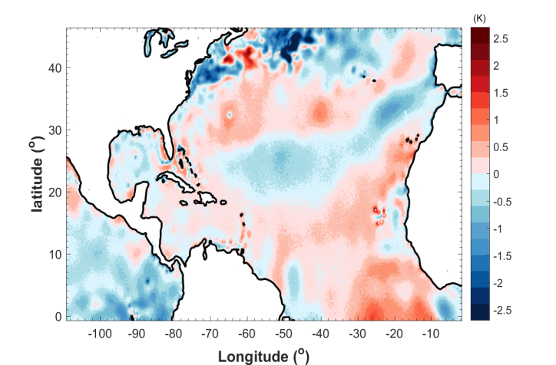
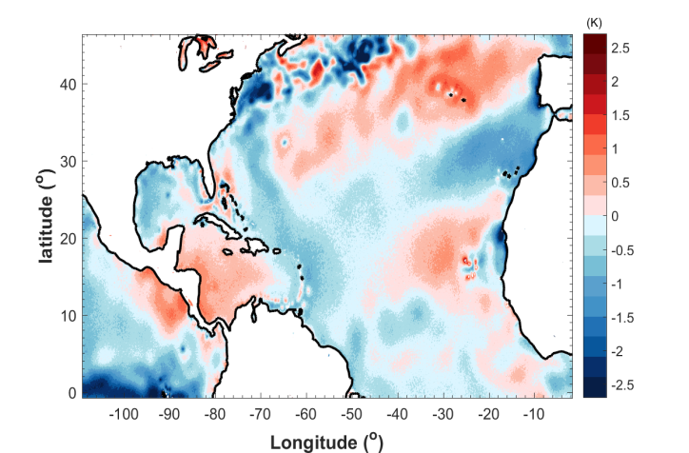
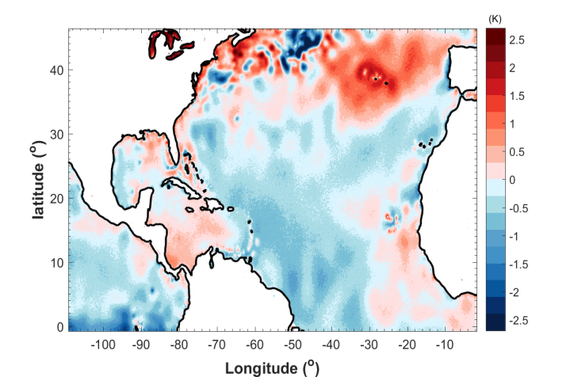
2. Numerical model and experimental design
August
September
October
2017
2017 – 06-16 mean

Slide 10
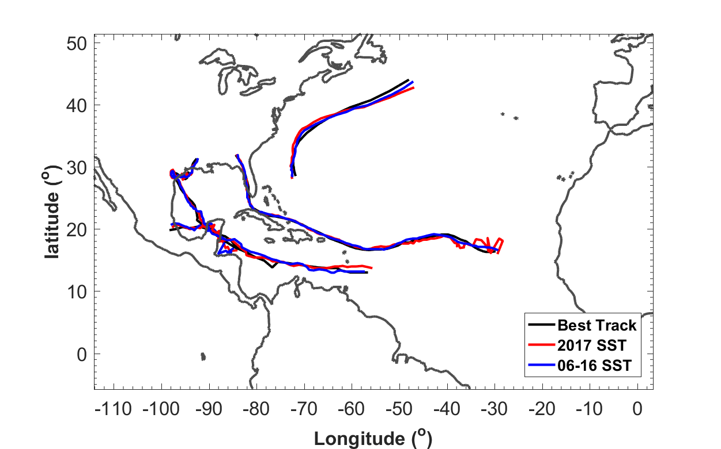
3. Results

Slide 11
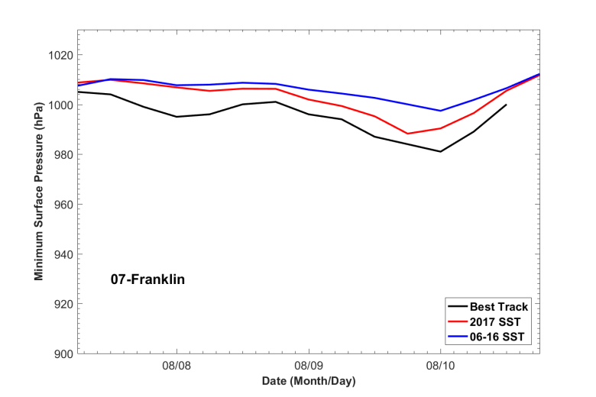
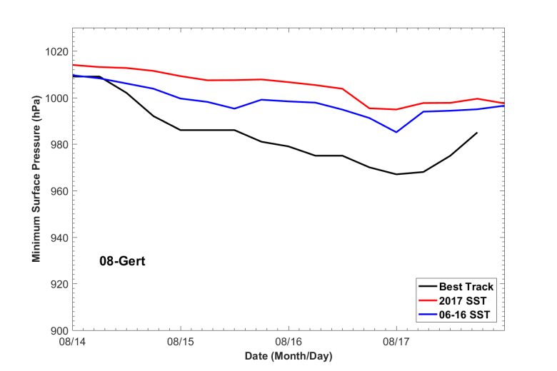
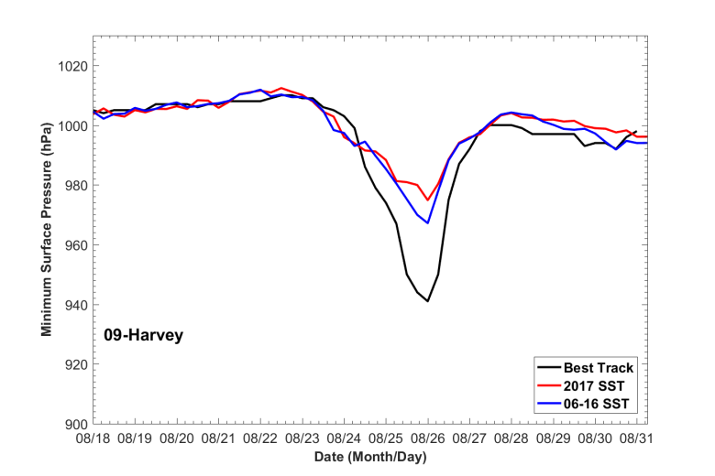
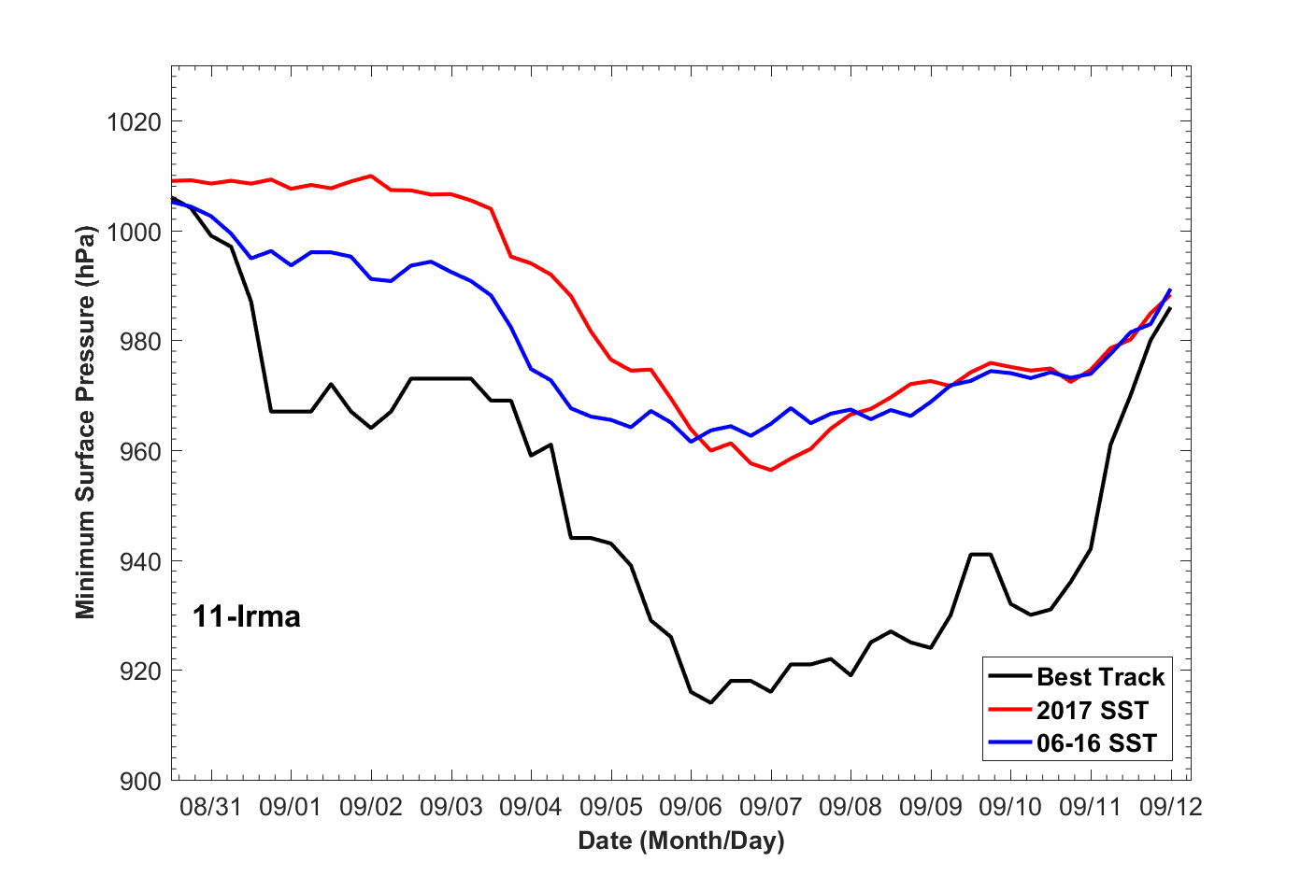
3. Results
Franklin
Gert
Minimum Surface Pressure
Harvey
Irma

Slide 12
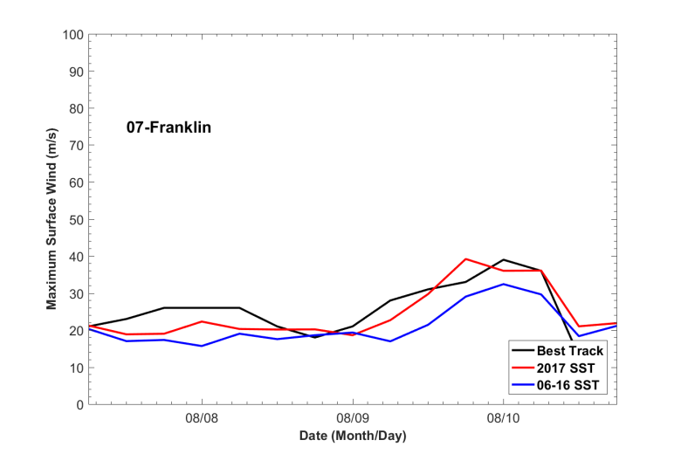
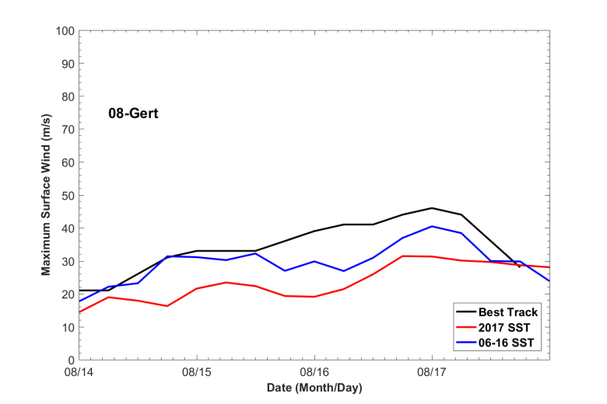
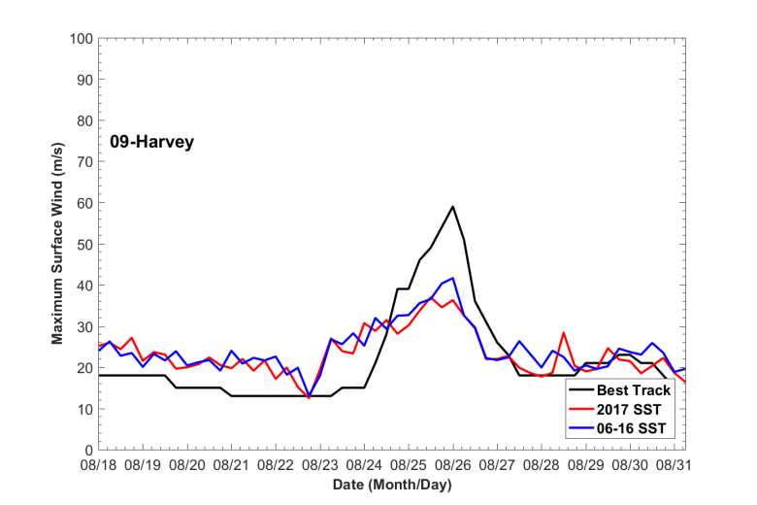
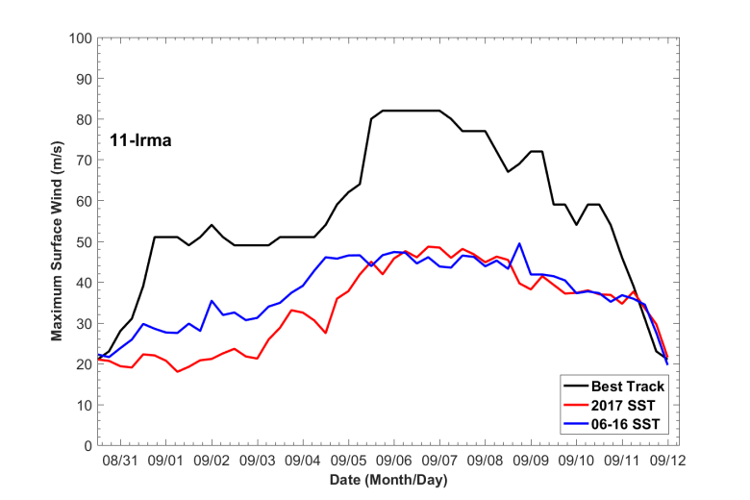
3. Results
Franklin
Gert
Maximum Surface Wind
Harvey
Irma

Slide 13
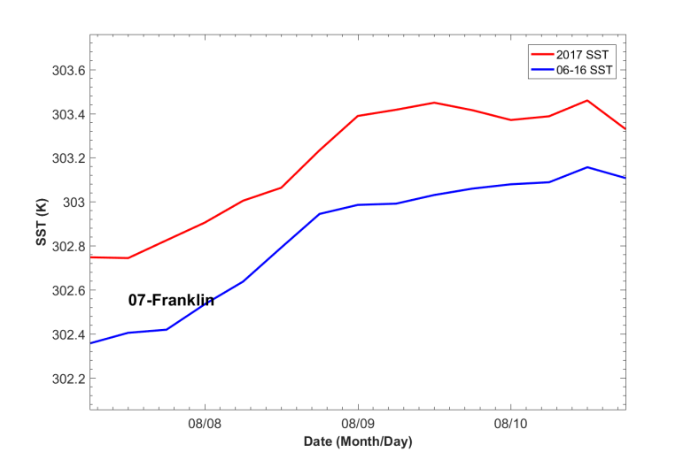
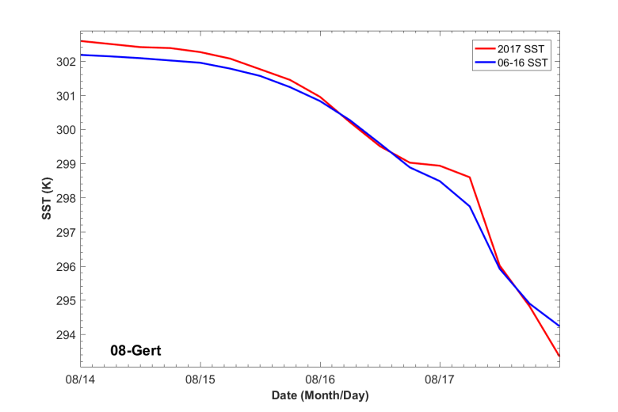
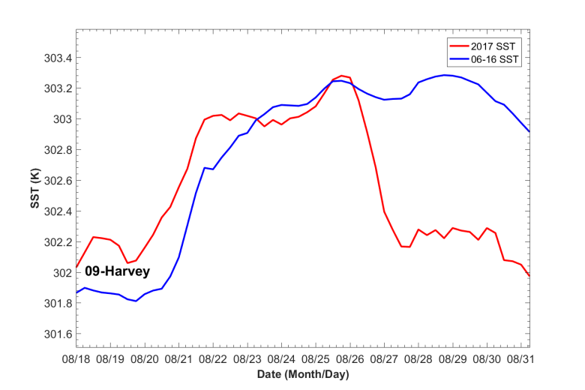
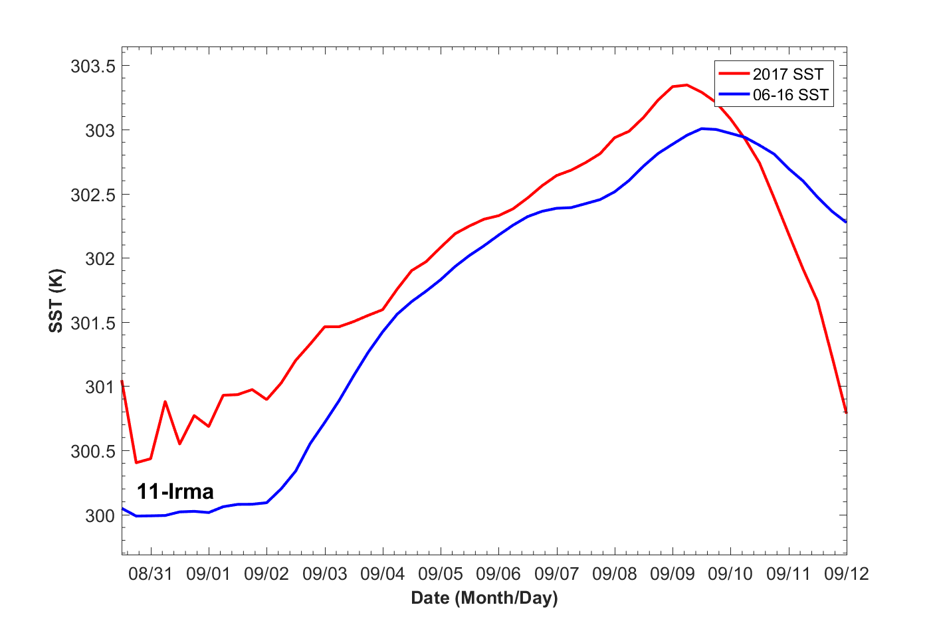
3. Results
Franklin
Gert
SST along the storm track
Harvey
Irma

Slide 14
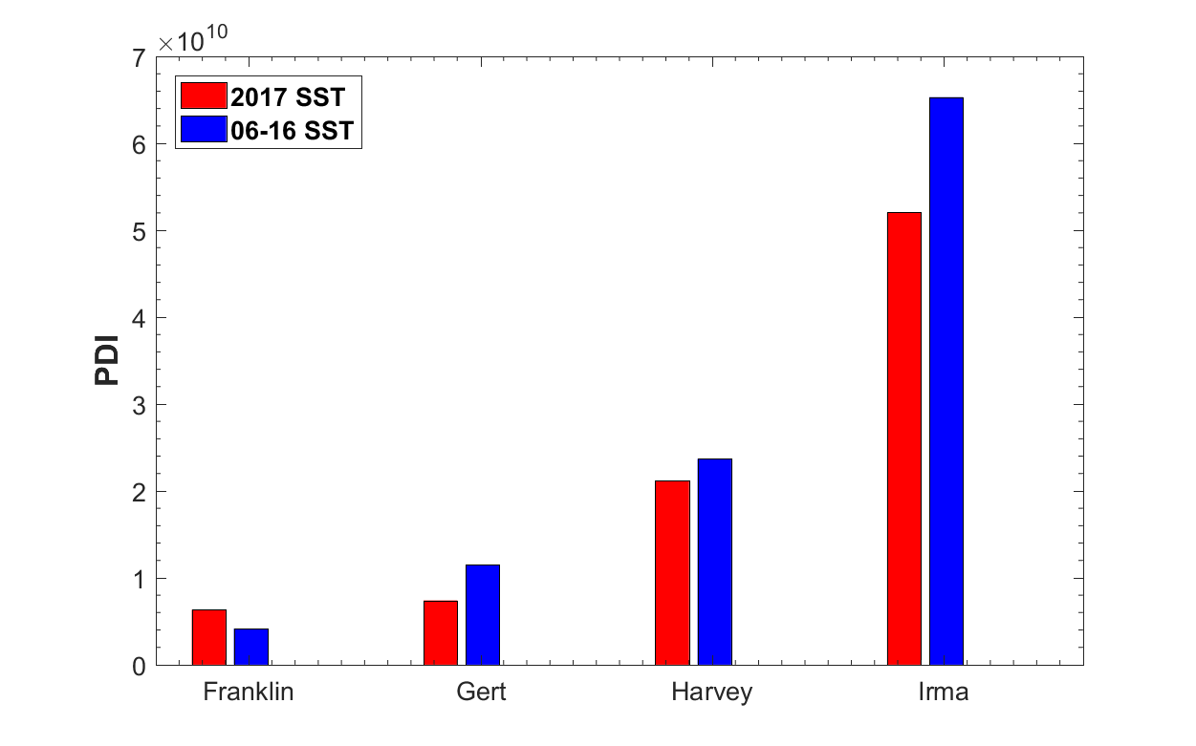
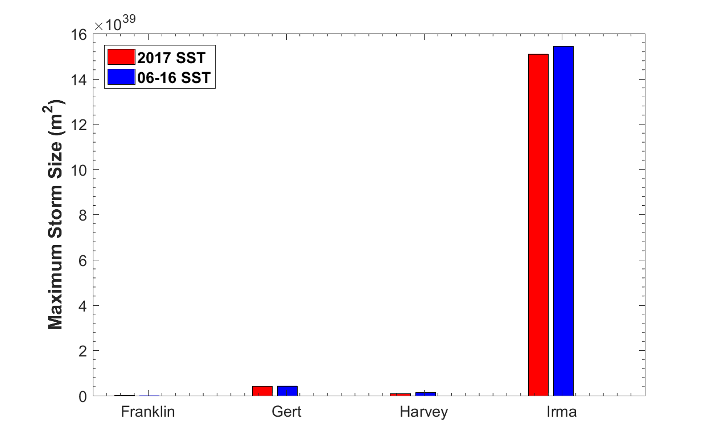
3. Results
Power Dissipation Index (PDI)
Maximum Strom Size (MSS)
(Accumulated area with surface wind > 17m/s)
PDI $= \int_{0}^{τ}{{V_{max}}_{}^{3}dt}$

Slide 15
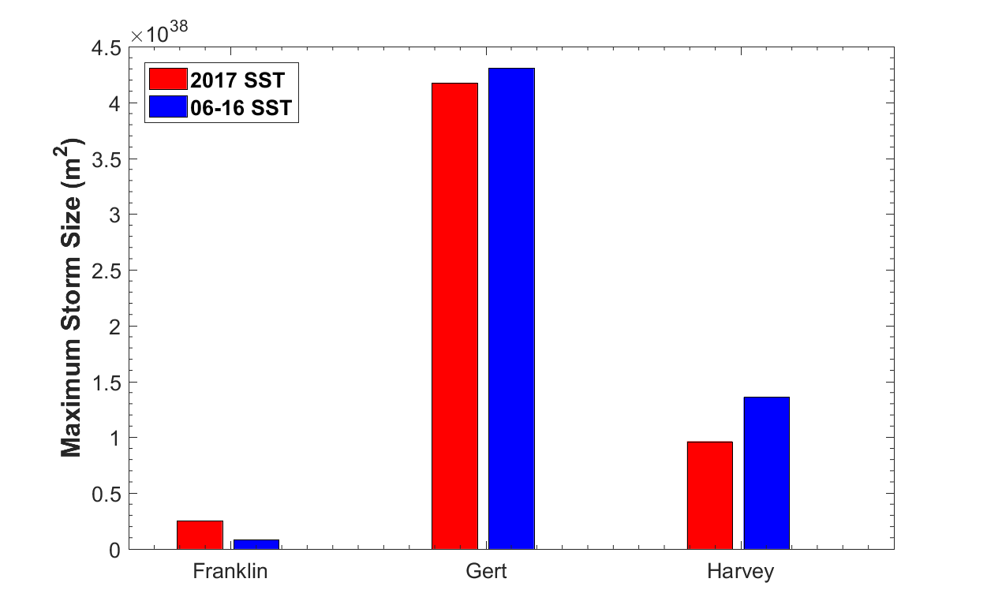
3. Results
Power Dissipation Index (PDI)
Maximum Strom Size (MSS)
(Accumulated area with surface wind > 17m/s)
PDI $= \int_{0}^{τ}{{V_{max}}_{}^{3}dt}$

Slide 16
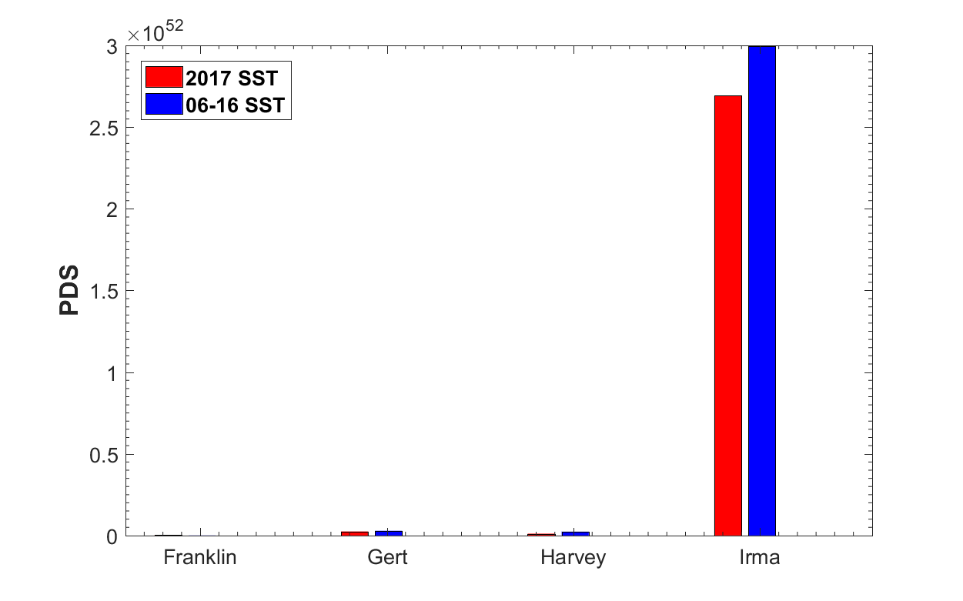
3. Results
Size-dependent TC destructive potential (PDS)
PDS $=\int_{0}^{τ}{\int_{0}^{A_{0}}{{|V|}^{3}}}$dAdt

Slide 17
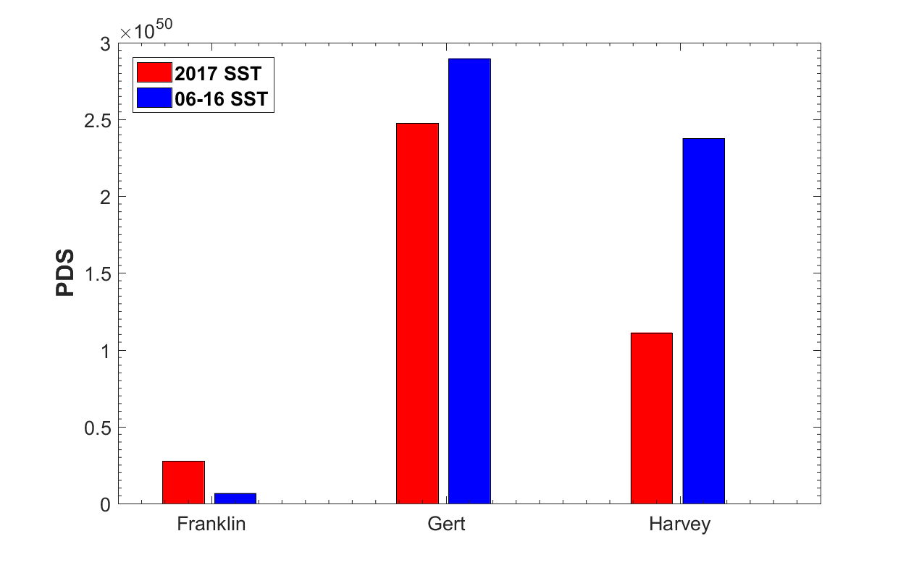
3. Results
Size-dependent TC destructive potential (PDS)
PDS $=\int_{0}^{τ}{\int_{0}^{A_{0}}{{|V|}^{3}}}$dAdt

Slide 18
4. Conclusion
1. Different hurricanes (intensity, size and destructiveness) changed differently after the SST is changed to the climatological mean (06-16)
2. The averaged storm size is increased with climatological SST
3. The total power dissipation and destructiveness of these four hurricanes are increased with climatological SST

Slide 19
Increasing destructiveness of tropical cyclones over the past 30 years
North Atlantic
Western North Pacific
(Emanuel, 2005, Nature)

